Slide 1
Social Media vs Productivity
Presented by: Racha Zayni & Ghada ElSaidi

Slide 2
df.head()
 | age | gender | job_type | daily_social_media_time | social_platform_preference | number_of_notifications | work_hours_per_day | perceived_productivity_score | actual_productivity_score
0 | 56 | Male | Unemployed | 4.180940 | Facebook | 61 | 6.753558 | 8.040464 | 7.291555
1 | 46 | Male | Health | 3.249603 | Twitter | 59 | 9.169296 | 5.063368 | 5.165093
2 | 32 | Male | Finance | NaN | Twitter | 57 | 7.910952 | 3.861762 | 3.474053
3 | 60 | Female | Unemployed | NaN | Facebook | 59 | 6.355027 | 2.916331 | 1.774869
4 | 25 | Male | IT | NaN | Telegram | 66 | 6.214096 | 8.868753 | NaN
stress_level | sleep_hours | screen_time_before_sleep | breaks_during_work | uses_focus_apps | has_digital_wellbeing_enabled | coffee_consumption_per_day | days_feeling_burnout_per_month | weekly_offline_hour | job_satisfaction_score
4.0 | 5.116546 | 0.419102 | 8 | False | False | 4 | 11 | 21.927072 | 6.336688
7.0 | 5.103897 | 0.671519 | 7 | True | True | 2 | 25 | 0.000000 | 3.412427
4.0 | 8.583222 | 0.624378 | 0 | True | False | 3 | 17 | 10.322044 | 2.474944
6.0 | 6.052984 | 1.204540 | 1 | False | False | 0 | 4 | 23.876616 | 1.733670
7.0 | 5.405706 | 1.876254 | 1 | False | True | 1 | 30 | 10.653519 | 9.693060

Slide 3
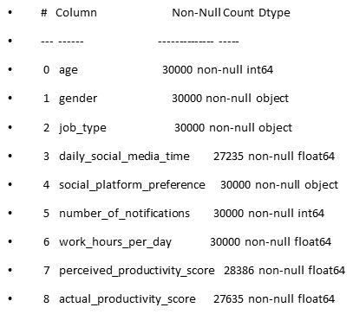
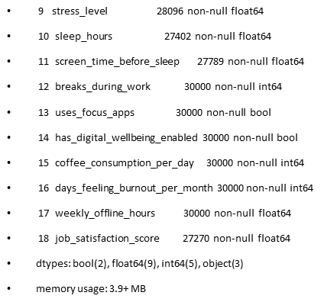
df.info()

Slide 4
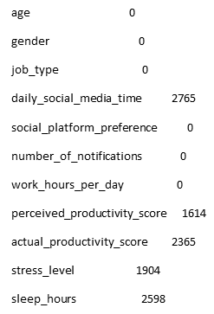
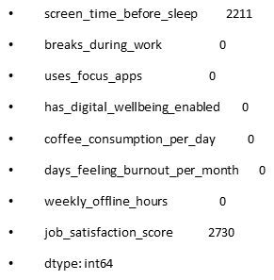
df.isnull().sum()

Slide 5
Data Preprocessing

Slide 6
EDA
Splitting the data
Filling Missing values
Removing Outliers
Categorize productivity
Checking for Balance
Scaling
Encoding
Features selection

Slide 7
Splitting data (80%, 20%)
X = social_df.drop(columns=['actual_productivity_score']) # keep score aside temporarily
y_score = social_df['actual_productivity_score']
X_train_raw, X_test_raw, y_score_train, y_score_test = train_test_split(
X, y_score, test_size=0.2, random_state=42
)

Slide 8
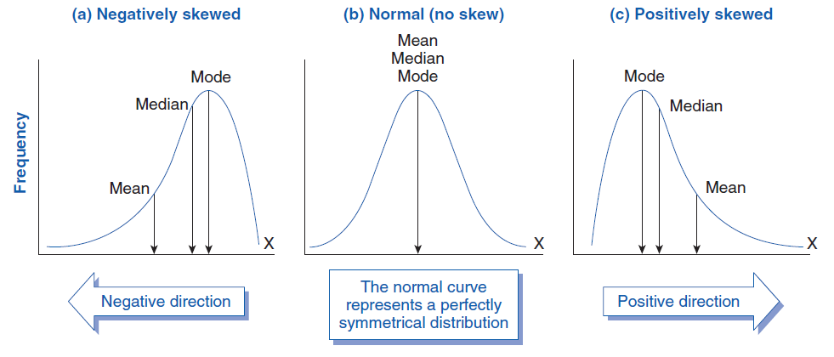
Skewness
We fill missing values with the mean (appropriate when the data is normally distributed and not heavily skewed).
You fill missing values with the median (more robust when data is skewed because it's less affected by extreme values/outliers).

Slide 9
Missing values
missing_cols = [
'daily_social_media_time', 'perceived_productivity_score', 'actual_productivity_score',
'stress_level', 'sleep_hours', 'screen_time_before_sleep', 'job_satisfaction_score'
]
# Fill train
for col in missing_cols:
skewness = train_df[col].skew()
if abs(skewness) < 0.5:
train_df[col] = train_df[col].fillna(train_df[col].mean())
else:
train_df[col] = train_df[col].fillna(train_df[col].median())

Slide 10
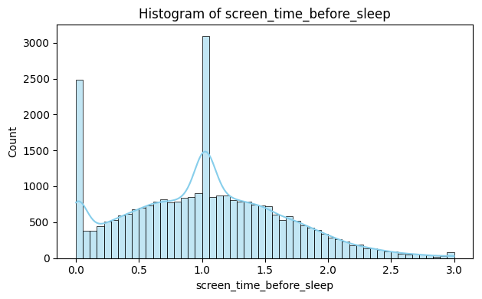
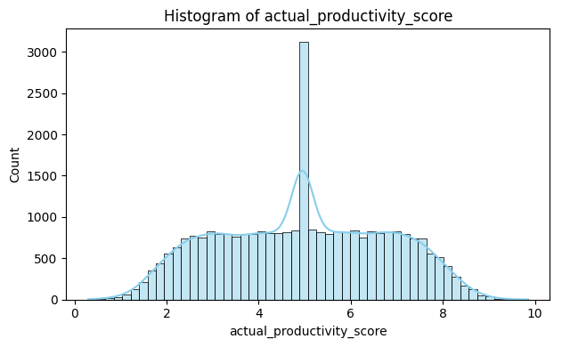
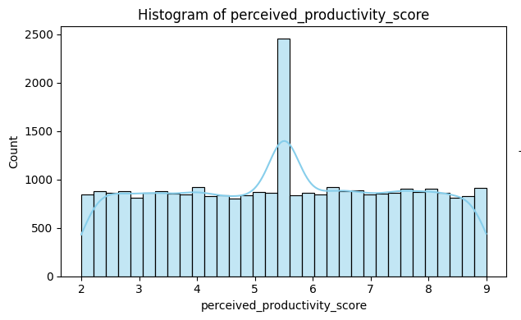
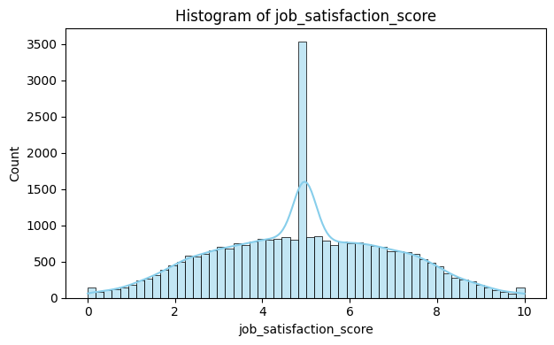
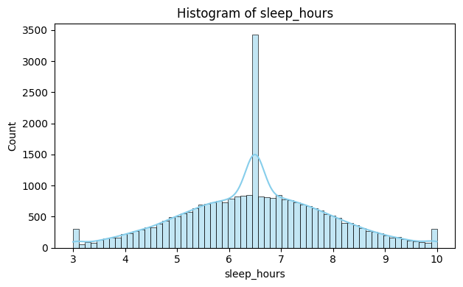
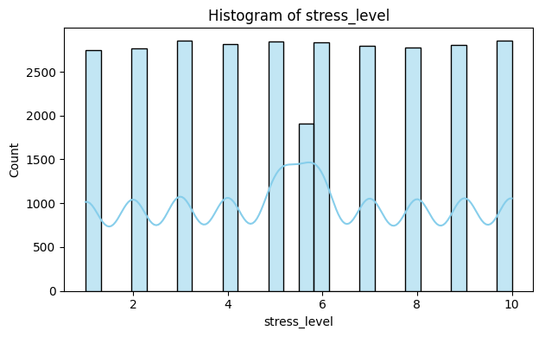
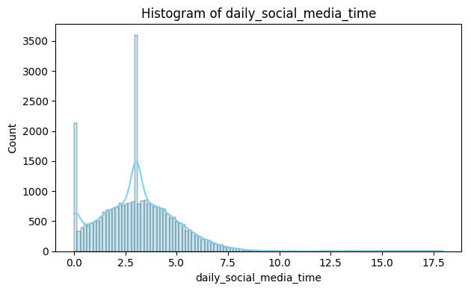
Univariate Analysis
Negatively skewed

Slide 11
Fill test using train stats
for col in missing_cols:
skewness = train_df[col].skew()
if abs(skewness) < 0.5:
test_df[col] = test_df[col].fillna(train_df[col].mean())
else:
test_df[col] = test_df[col].fillna(train_df[col].median())

Slide 12
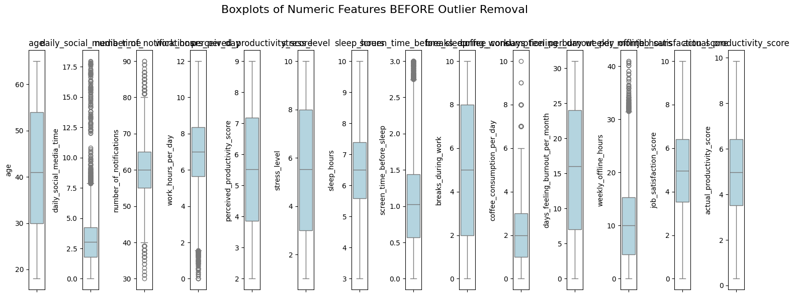
Outliers

Slide 13
Remove outliers using quantile method (IQR)
Q1 = train_df[numeric_cols].quantile(0.25)
Q3 = train_df[numeric_cols].quantile(0.75)
IQR = Q3 - Q1
lower_bound = Q1 - 1.5 * IQR
upper_bound = Q3 + 1.5 * IQR
non_outliers_mask = ~((train_df[numeric_cols] < lower_bound) | (train_df[numeric_cols] > upper_bound)).any(axis=1)
train_df_clean = train_df[non_outliers_mask].reset_index(drop=True)

Slide 14
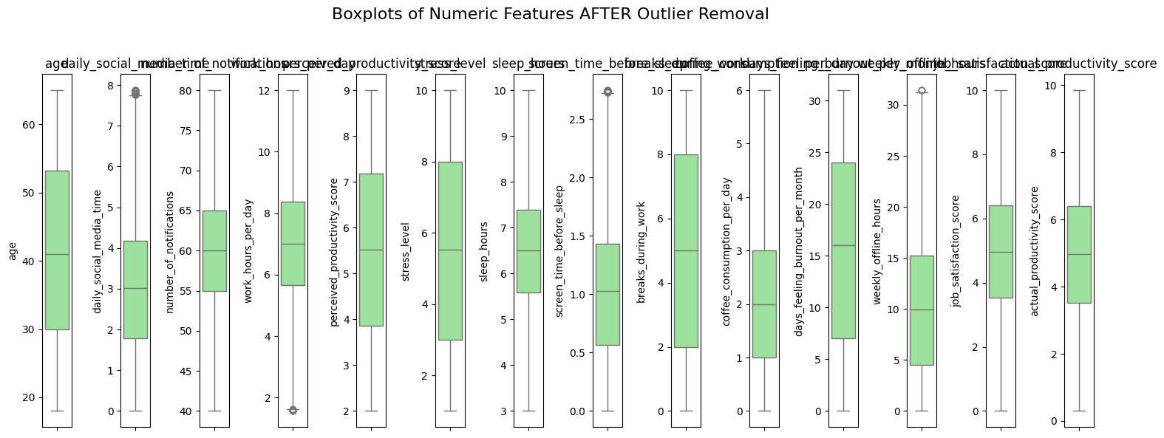

Slide 15
Categorize productivity (Target)
# Convert actual productivity score to categorical classes
train_df_clean['productivity_category'], bins = pd.qcut(
train_df_clean['actual_productivity_score'], q=3,
labels=['Low', 'Medium', 'High'], retbins=True
)
print("Bin edges:", bins)# Target and features
Output: Bin edges: [0.29847571 4.09721222 5.83370539 9.84625801]
!
So, our classification dataset is balanced !

Slide 16
Apply same bins to test set
test_df['productivity_category'] = pd.cut(
test_df['actual_productivity_score'],
bins=bins,
labels=['Low', 'Medium', 'High'],
include_lowest=True
)
Then, drop test values that fall outside the bin ranges:
test_df_clean = test_df.dropna(subset=['productivity_category']).reset_index(drop=True)

Slide 17
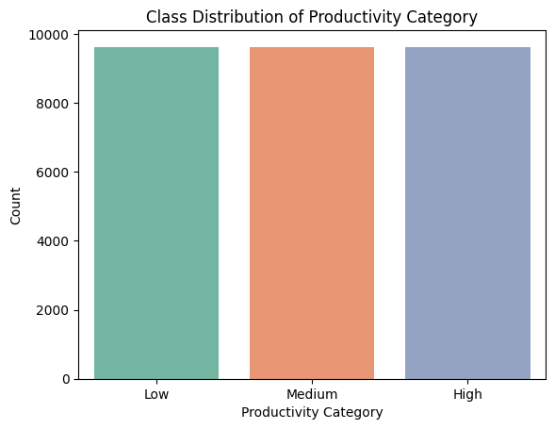
Checking for Balance
sns.countplot(x=y_class, palette='Set2')
plt.title("Class Distribution of Productivity Category")
plt.xlabel("Productivity Category")
plt.ylabel("Count")
plt.show()

Slide 18
Scaling and Encoding
numeric_features = X_train.select_dtypes(include=['int64', 'float64']).columns.tolist()
categorical_features = X_train.select_dtypes(include=['object', 'bool']).columns.tolist()
preprocessor = ColumnTransformer([
('num', StandardScaler(), numeric_features),
('cat', OneHotEncoder(handle_unknown='ignore'), categorical_features)
])
X_train_processed = preprocessor.fit_transform(X_train)
age: mean=41.5011, variance=191.9205, std_dev=13.8535
daily_social_media_time: mean=3.0136, variance=3.0450, std_dev=1.7450 number_of_notifications: mean=59.8543, variance=55.7567, std_dev=7.4670
work_hours_per_day: mean=7.0090, variance=3.8793, std_dev=1.9696
perceived_productivity_score: mean=5.5159, variance=3.8746, std_dev=1.9684
days_feeling_burnout_per_month: mean=15.5243, variance=85.6387, std_dev=9.2541
weekly_offline_hours: mean=10.2629, variance=50.9579, std_dev=7.1385
job_satisfaction_score: mean=4.9669, variance=4.0905, std_dev=2.0225
→Apply the statistical values extracted from training set to testing set

Slide 19
Features Selection (K-Best select)
selector = SelectKBest(score_func=f_classif, k=5)
selector.fit(X_train_processed, y_train_enc)
X_train_selected = selector.transform(X_train_processed)
X_test_selected = selector.transform(X_test_processed) num_features_names = numeric_features
cat_features_names =
preprocessor.named_transformers_['cat'].get_feature_names_out(categorical_features).tolist()
all_feature_names = num_features_names + cat_features_names
selected_feature_indices = selector.get_support(indices=True)
selected_feature_names = [all_feature_names[i] for i in selected_feature_indices]
print("🔍 Selected Features with SelectKBest (k=5) :")
for feat in selected_feature_names:
print(f" - {feat}")

Slide 20
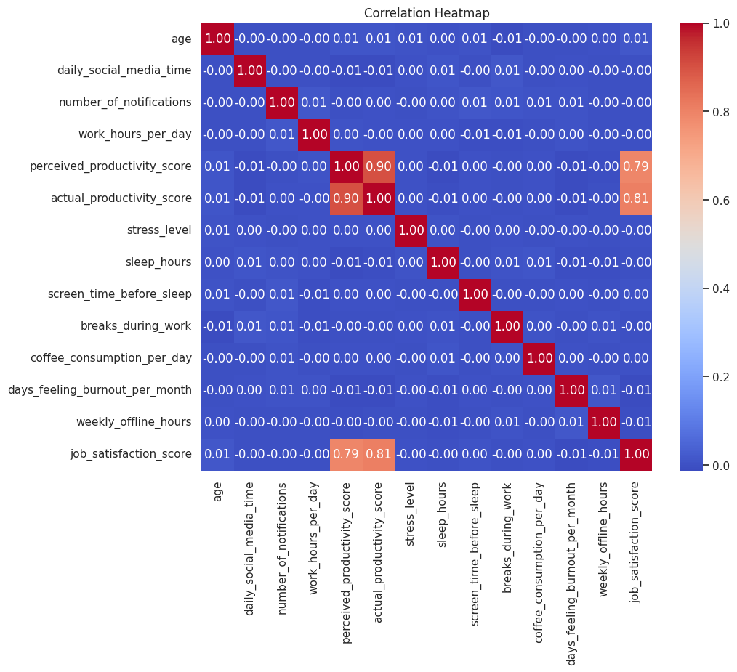
Correlation Heatmap (linearity)
if len(numeric_features) >= 4:
plt.figure(figsize=(10, 8))
corr = social_df[numeric_features].corr()
sns.heatmap(corr, annot=True, cmap='coolwarm', fmt='.2f')
plt.title('Correlation Heatmap')
plt.show()

Slide 21
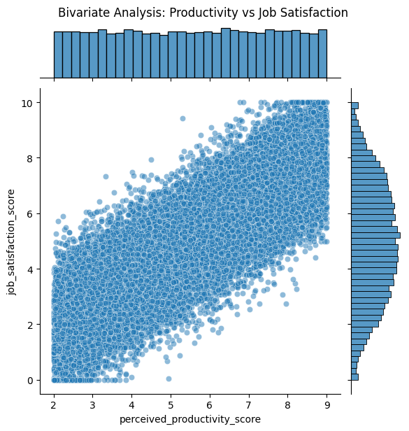
Bivariate analysis

Slide 22
Model Development phase

Slide 23
Artificiel Neural Networks
1- Hyperparameter tuning
2-Model training
3-Model evaluation

Slide 24
Hyperparameter tuning (GridSearchCV)
nb of hidden layer
nb of units (neurons per layer)
batch size: The number of training samples used to update the model's weights once
epochs: One epoch = the model has seen the entire training dataset once.
learning rate: How big the step is during weight updates

Slide 25
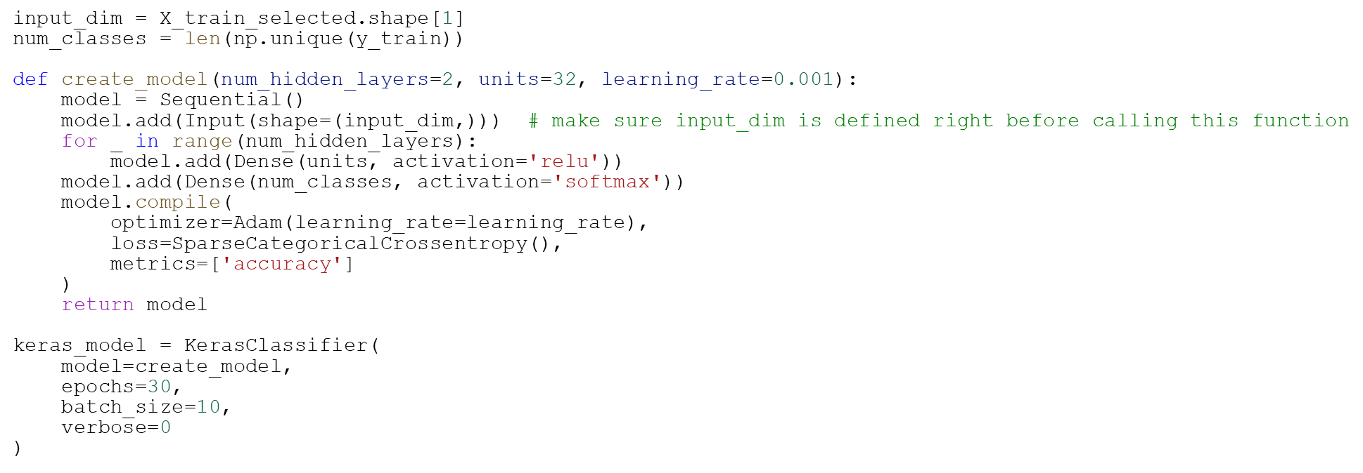
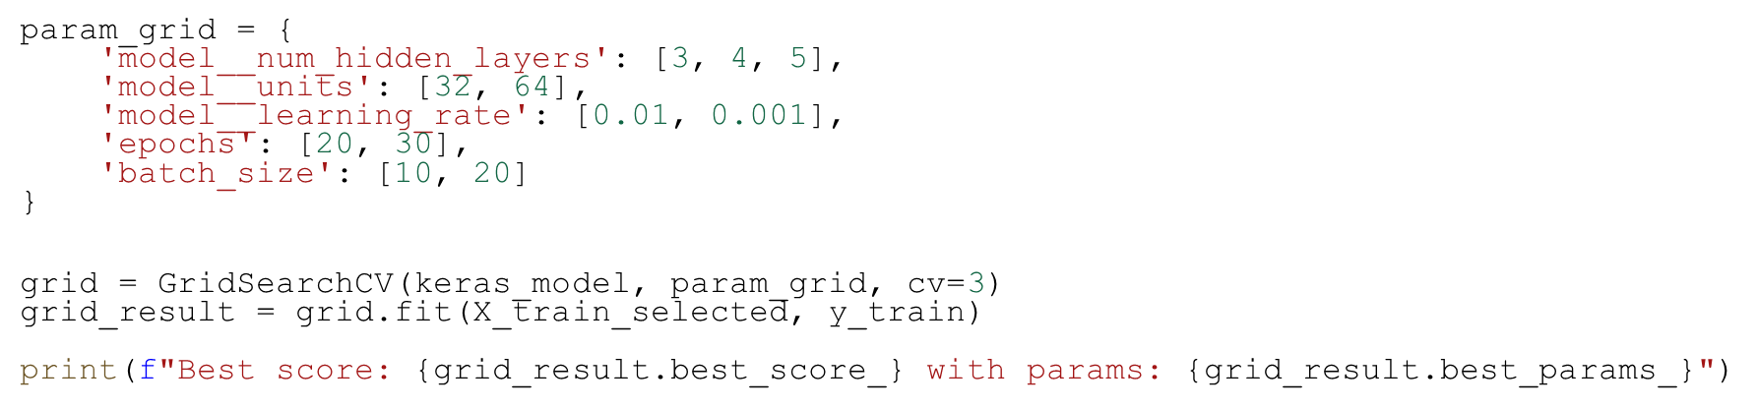
✅Best score: 0.8219167869895859
✅ Best Parameters: {'batch_size': 10, 'epochs': 30, 'model__learning_rate': 0.001, 'model__num_hidden_layers': 4, 'model__units': 64}

Slide 26
Model training
def create_model():
model = Sequential([
InputLayer(input_shape=(input_dim,)),
Dense(64, activation='relu'), # 1st hidden layer
Dense(64, activation='relu'), # 2nd hidden layer (added)
Dense(64, activation='relu'), # 3rd hidden layer
Dense(64, activation='relu'), # 4th hidden layer (added)
Dense(num_classes, activation='softmax')
])
optimizer = Adam(learning_rate=0.001)
model.compile(
optimizer=optimizer,
loss=SparseCategoricalCrossentropy(),
metrics=['accuracy']
)
return model
model = KerasClassifier(
model=create_model,
epochs=30,
batch_size=10,
verbose=0
)
# Fit the model
model.fit(X_train_selected, y_train, validation_split=0.2, verbose=1
)

Slide 27
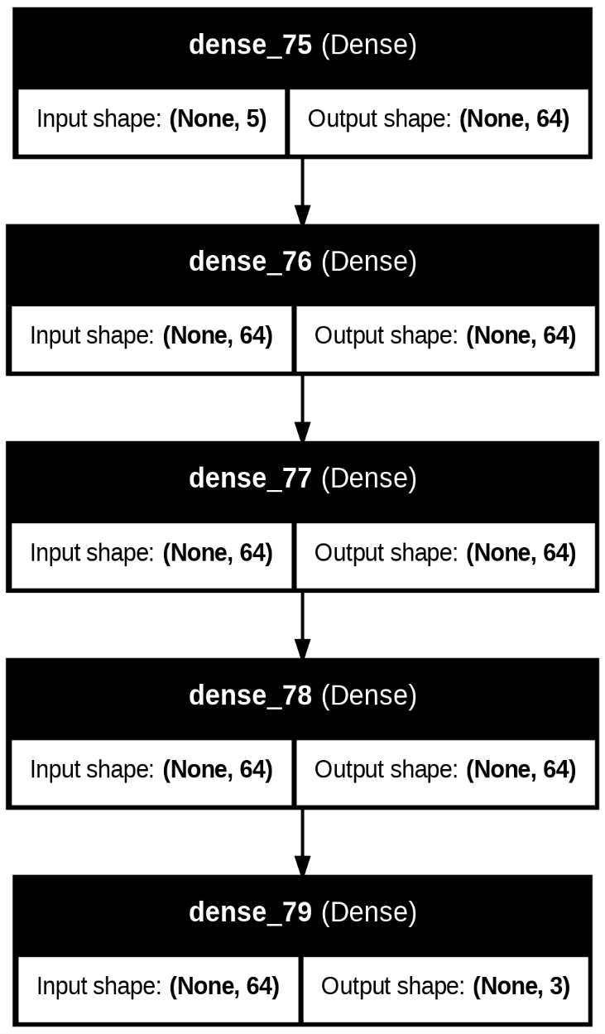
2310/2310 ━━━━━━━━━━━━━━━━━━━━ 15s 4ms/step - accuracy: 0.7858 - loss: 0.5073 Epoch 2/30 2310/2310 ━━━━━━━━━━━━━━━━━━━━ 18s 3ms/step - accuracy: 0.8116 - loss: 0.4495 Epoch 3/30 2310/2310 ━━━━━━━━━━━━━━━━━━━━ 10s 3ms/step - accuracy: 0.8133 - loss: 0.4473 Epoch 4/30 2310/2310 ━━━━━━━━━━━━━━━━━━━━ 6s 3ms/step - accuracy: 0.8119 - loss: 0.4490 Epoch 5/30 2310/2310 ━━━━━━━━━━━━━━━━━━━━ 10s 3ms/step - accuracy: 0.8175 - loss: 0.4440 Epoch 6/30 2310/2310 ━━━━━━━━━━━━━━━━━━━━ 8s 3ms/step - accuracy: 0.8194 - loss: 0.4346 Epoch 7/30 2310/2310 ━━━━━━━━━━━━━━━━━━━━ 6s 3ms/step - accuracy: 0.8219 - loss: 0.4333 Epoch 8/30 2310/2310 ━━━━━━━━━━━━━━━━━━━━ 12s 4ms/step - accuracy: 0.8219 - loss: 0.4317 Epoch 9/30 2310/2310 ━━━━━━━━━━━━━━━━━━━━ 8s 3ms/step - accuracy: 0.8197 - loss: 0.4356 Epoch 10/30 2310/2310 ━━━━━━━━━━━━━━━━━━━━ 7s 3ms/step - accuracy: 0.8196 - loss: 0.4311 Epoch 11/30 2310/2310 ━━━━━━━━━━━━━━━━━━━━ 10s 3ms/step - accuracy: 0.8162 - loss: 0.4351 Epoch 12/30 2310/2310 ━━━━━━━━━━━━━━━━━━━━ 9s 4ms/step - accuracy: 0.8215 - loss: 0.4304 Epoch 13/30 2310/2310 ━━━━━━━━━━━━━━━━━━━━ 6s 3ms/step - accuracy: 0.8214 - loss: 0.4272 Epoch 14/30 2310/2310 ━━━━━━━━━━━━━━━━━━━━ 8s 3ms/step - accuracy: 0.8216 - loss: 0.4248 Epoch 15/30 2310/2310 ━━━━━━━━━━━━━━━━━━━━ 12s 4ms/step - accuracy: 0.8234 - loss: 0.4255 Epoch 16/30 2310/2310 ━━━━━━━━━━━━━━━━━━━━ 6s 3ms/step - accuracy: 0.8272 - loss: 0.4215 Epoch 17/30 2310/2310 ━━━━━━━━━━━━━━━━━━━━ 8s 3ms/step - accuracy: 0.8263 - loss: 0.4243 Epoch 18/30 2310/2310 ━━━━━━━━━━━━━━━━━━━━ 9s 3ms/step - accuracy: 0.8262 - loss: 0.4161 Epoch 19/30 2310/2310 ━━━━━━━━━━━━━━━━━━━━ 7s 3ms/step - accuracy: 0.8222 - loss: 0.4238 Epoch 20/30 2310/2310 ━━━━━━━━━━━━━━━━━━━━ 7s 3ms/step - accuracy: 0.8251 - loss: 0.4231 Epoch 21/30 2310/2310 ━━━━━━━━━━━━━━━━━━━━ 7s 3ms/step - accuracy: 0.8215 - loss: 0.4240 Epoch 22/30 2310/2310 ━━━━━━━━━━━━━━━━━━━━ 11s 3ms/step - accuracy: 0.8248 - loss: 0.4164 Epoch 23/30 2310/2310 ━━━━━━━━━━━━━━━━━━━━ 6s 3ms/step - accuracy: 0.8263 - loss: 0.4207 Epoch 24/30 2310/2310 ━━━━━━━━━━━━━━━━━━━━ 11s 3ms/step - accuracy: 0.8268 - loss: 0.4173 Epoch 25/30 2310/2310 ━━━━━━━━━━━━━━━━━━━━ 10s 3ms/step - accuracy: 0.8258 - loss: 0.4193 Epoch 26/30 2310/2310 ━━━━━━━━━━━━━━━━━━━━ 11s 3ms/step - accuracy: 0.8233 - loss: 0.4247 Epoch 27/30 2310/2310 ━━━━━━━━━━━━━━━━━━━━ 11s 3ms/step - accuracy: 0.8239 - loss: 0.4237 Epoch 28/30 2310/2310 ━━━━━━━━━━━━━━━━━━━━ 9s 3ms/step - accuracy: 0.8261 - loss: 0.4202 Epoch 29/30 2310/2310 ━━━━━━━━━━━━━━━━━━━━ 10s 3ms/step - accuracy: 0.8247 - loss: 0.4217 Epoch 30/30 2310/2310 ━━━━━━━━━━━━━━━━━━━━ 8s 3ms/step - accuracy: 0.8281 - loss: 0.4174 188/188 - 1s - 3ms/step - accuracy: 0.8218 - loss: 0.4265 0.42648470401763916 0.821803629398346
keras_model = create_model()
plot_model(keras_model, to_file='model_plot.png', show_shapes=True, show_layer_names=True)
display(Image('model_plot.png'))

Slide 28
1848/1848 ━━━━━━━━━━━━━━━━━━━━ 7s 3ms/step - accuracy: 0.7854 - loss: 0.5143 - val_accuracy: 0.7952 - val_loss: 0.4744
Epoch 2/30 1848/1848 ━━━━━━━━━━━━━━ 10s 3ms/step - accuracy: 0.8147 - loss: 0.4449 - val_accuracy: 0.8113 - val_loss: 0.4554
Epoch 3/30 1848/1848 ━━━━━━━━━━━━━━ 6s 3ms/step - accuracy: 0.8202 - loss: 0.4394 - val_accuracy: 0.8145 - val_loss: 0.4536
Epoch 4/30 1848/1848 ━━━━━━━━━━━━━━ 9s 3ms/step - accuracy: 0.8190 - loss: 0.4433 - val_accuracy: 0.8136 - val_loss: 0.4504
Epoch 5/30 1848/1848 ━━━━━━━━━━━━━━ 6s 3ms/step - accuracy: 0.8209 - loss: 0.4309 - val_accuracy: 0.8158 - val_loss: 0.4478
Epoch 6/30 1848/1848 ━━━━━━━━━━━━━━ 11s 3ms/step - accuracy: 0.8193 - loss: 0.4399 - val_accuracy: 0.8078 - val_loss: 0.4595
Epoch 7/30 1848/1848 ━━━━━━━━━━━━━━ 10s 3ms/step - accuracy: 0.8236 - loss: 0.4329 - val_accuracy: 0.8152 - val_loss: 0.4490
Epoch 8/30 1848/1848 ━━━━━━━━━━━━━━ 6s 3ms/step - accuracy: 0.8195 - loss: 0.4355 - val_accuracy: 0.8119 - val_loss: 0.4522
Epoch 9/30 1848/1848 ━━━━━━━━━━━━━━ 11s 3ms/step - accuracy: 0.8224 - loss: 0.4337 - val_accuracy: 0.8147 - val_loss: 0.4510
Epoch 10/30 1848/1848 ━━━━━━━━━━━━━ 5s 3ms/step - accuracy: 0.8200 - loss: 0.4289 - val_accuracy: 0.8123 - val_loss: 0.4587
Epoch 24/30 1848/1848 ━━━━━━━━━━━━━━10s 3ms/step - accuracy: 0.8234 - loss: 0.4217 - val_accuracy: 0.8158 - val_loss: 0.4429
Epoch 25/30 1848/1848 ━━━━━━━━━━━━━━ 6s 3ms/step - accuracy: 0.8281 - loss: 0.4146 - val_accuracy: 0.8106 - val_loss: 0.4492
Epoch 26/30 1848/1848 ━━━━━━━━━━━━━━ 5s 3ms/step - accuracy: 0.8270 - loss: 0.4175 - val_accuracy: 0.8141 - val_loss: 0.4419
Epoch 27/30 1848/1848 ━━━━━━━━━━━━━━ 5s 3ms/step - accuracy: 0.8273 - loss: 0.4158 - val_accuracy: 0.8102 - val_loss: 0.4445
Epoch 28/30 1848/1848 ━━━━━━━━━━━━━━ 6s 3ms/step - accuracy: 0.8347 - loss: 0.4079 - val_accuracy: 0.8147 - val_loss: 0.4398
Epoch 29/30 1848/1848 ━━━━━━━━━━━━━━ 5s 3ms/step - accuracy: 0.8247 - loss: 0.4203 - val_accuracy: 0.8143 - val_loss: 0.4435
Epoch 30/30 1848/1848 ━━━━━━━━━━━━━━ 7s 3ms/step - accuracy: 0.8329 - loss: 0.4076 - val_accuracy: 0.8128 - val_loss: 0.4480
188/188 - 1s - 3ms/step - accuracy: 0.8220 - loss: 0.4265

Slide 29
Backword propagation
Layer (type) ┃ Output Shape ┃ Param #
---------------------------------------------------------------------------┃
│ dense_10 (Dense) │ (None, 64) │ 384 │
├─────────────────────────────────┼────────────────────────┼───────────────┤
│ dense_11 (Dense) │ (None, 64) │ 4,160 │
├─────────────────────────────────┼────────────────────────┼───────────────┤
│ dense_12 (Dense) │ (None, 64) │ 4,160 │
├─────────────────────────────────┼────────────────────────┼───────────────┤
│ dense_13 (Dense) │ (None, 64) │ 4,160 │
├─────────────────────────────────┼────────────────────────┼───────────────┤
│ dense_14 (Dense) │ (None, 3) │ 195 │
Epoch 30:
Layer 5 (backward): Neuron 0 first 5 weights: [-0.03742458 -1.6555421 -0.11419478 0.26276207 -0.21847779]
Layer 4 (backward): Neuron 0 first 5 weights: [-0.09752201 -0.02178353 0.09747047 0.04057218 0.05066625]
Layer 3 (backward): Neuron 0 first 5 weights: [-0.02484785 0.14389396 -0.14555076 0.31889078 0.05331968]
Layer 2 (backward): Neuron 0 first 5 weights: [-0.60131717 -0.19934924 -0.7742542 -0.11080083 -0.3455812 ]
Layer 1 (backward): Neuron 0 first 5 weights: [-0.2956777 0.19294187 -0.32689008 -0.2861264 0.10434556]

Slide 30
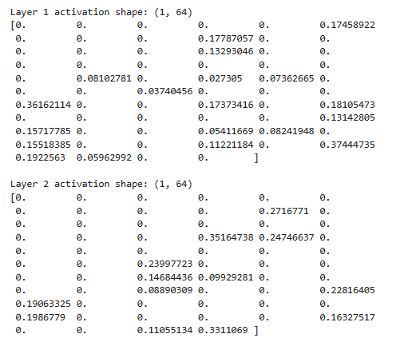
Forward propagation
Layer 1:
z1 = W1·x + b1
a1 = ReLU(z1)
Layer 2:
z2 = W2·a1 + b2
a2 = ReLU(z2)
Layer 3:
z3 = W3·a2 + b3
a3 = ReLU(z3)
Layer 4:
z4 = W4·a3 + b4
a4 = ReLU(z4)
Output Layer:
z5 = W5·a4 + b5
a5 = softmax(z5) →
Final predicted class probabilities

Slide 31
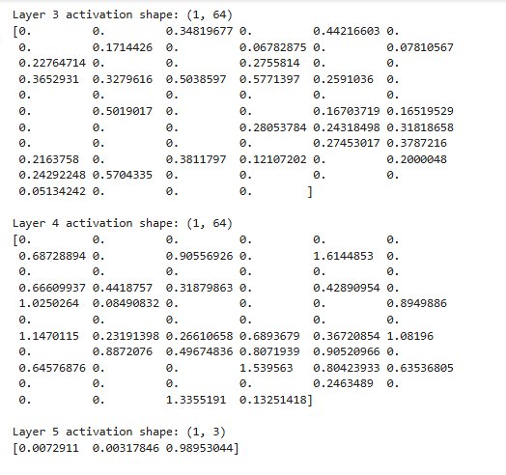
Forward propagation
Final predicted probabilities (softmax output): [0.0072911 0.00317846 0.98953044]
Predicted class :High

Slide 32
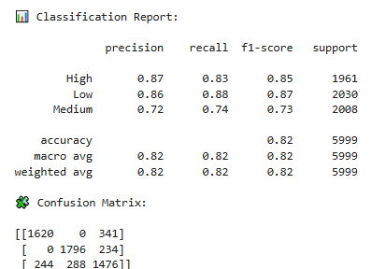
Model evaluation
y_pred = model.predict(X_test_selected)
print("\n✅ Test Set Accuracy: {:.2f}%".format(model.score(X_test_selected, y_test) * 100))
print("\n📊 Classification Report:\n")
print(classification_report(y_test, y_pred))
print("🧩 Confusion Matrix:\n")
print(confusion_matrix(y_test, y_pred))
✅ Testing Accuracy: 82.36%
✅ Training Accuracy: 82.81%

Slide 33
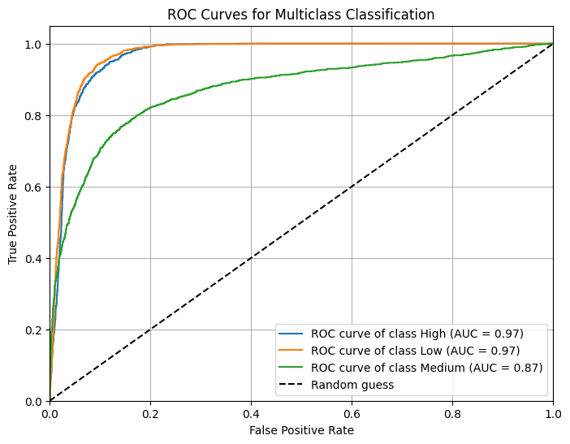
ROC and AUC
y_test_bin = label_binarize(y_test_enc, classes=np.arange(num_classes))
y_proba = model.predict_proba(X_test_selected)
plt.figure(figsize=(8,6))
for i in range(num_classes):
fpr, tpr, _ = roc_curve(y_test_bin[:, i], y_proba[:, i])
roc_auc = auc(fpr, tpr)
plt.plot(fpr, tpr, label=f'ROC curve of class {le.classes_[i]} (AUC = {roc_auc:.2f})')
plt.plot([0,1], [0,1], 'k--', label='Random guess')
plt.xlim([0, 1])
plt.ylim([0, 1.05])
plt.xlabel('False Positive Rate')
plt.ylabel('True Positive Rate')
plt.title('ROC Curves for Multiclass Classification')
plt.legend(loc='lower right')
plt.grid()
plt.show()

Slide 34
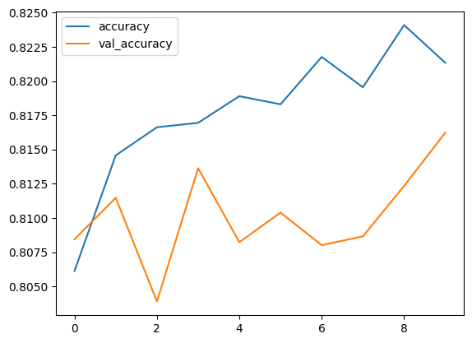
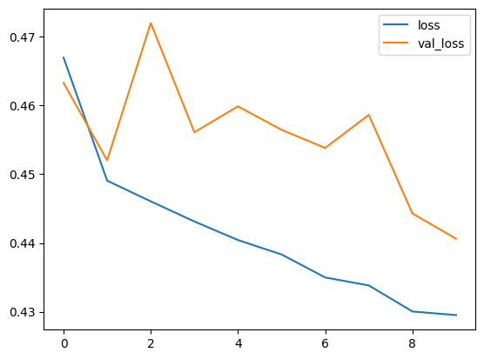

Slide 35
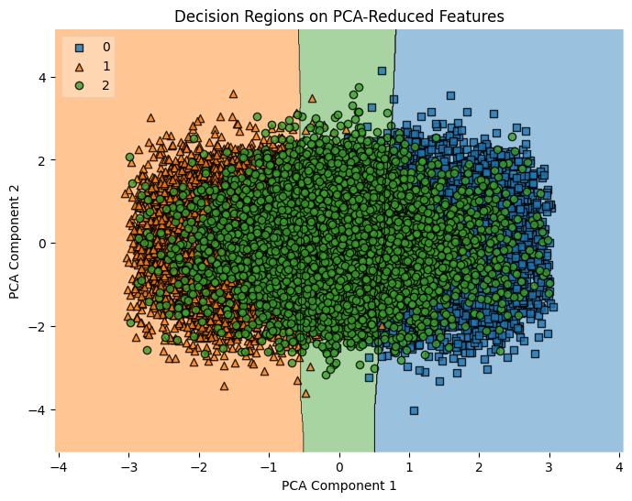
Decision boundary (dimensionality reduction)
Apply PCA to reduce from 5 features to 2
Define a new model that accepts 2 input features
Train on PCA-reduced data
Plot decision regions on PCA-reduced data
PCA Component 1 and Component 2 are linear combinations of the original features that capture the first and second highest variances in the data, respectively, with Component 2 being orthogonal to Component 1.

Slide 36
Decision Trees
1-Best depth
2-Gini vs Entropy
3-Confusion Matrix
4-ROC and AUC

Slide 37
Choosing the depth
#Analyse précision en fonction de la profondeur d’arbre avec SelectKBest
depths = range(2, 15)
train_accs = []#pour stocker les accuracy sur les ensembles d'entraînement et de test.
test_accs = []
for depth in depths:
pipe = Pipeline([
('preprocessor', preprocessor),
('feature_selection', SelectKBest(score_func=f_classif, k=k)),
('classifier', DecisionTreeClassifier(max_depth=depth, random_state=42))#classifieur DT limité à la profondeur depth
])
pipe.fit(X_train, y_train)#Entraîne tout le pipeline sur X_train et y_train
train_accs.append(accuracy_score(y_train, pipe.predict(X_train)))
test_accs.append(accuracy_score(y_test, pipe.predict(X_test)))
plt.figure(figsize=(8, 5))
plt.plot(depths, train_accs, marker='o', label='Training Accuracy')
plt.plot(depths, test_accs, marker='s', label='Testing Accuracy')
plt.xlabel("Tree Depth")
plt.ylabel("Accuracy")
plt.title(f"Testing vs Training Accuracy by Tree Depth (Top {k} Features Selected)")
plt.legend()
plt.grid(True)
plt.show()

Slide 38
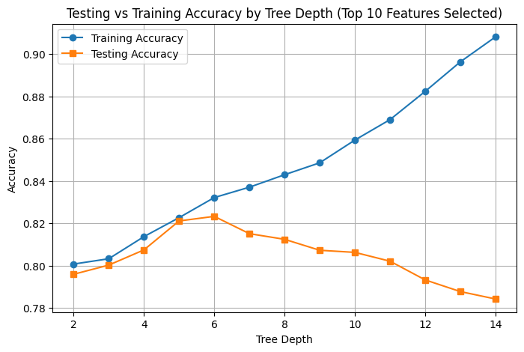
At low depths (2–4), the model is too simple to capture the underlying patterns → this is called underfitting.
Beyond depth 6, the testing accuracy drops, while the training accuracy keeps increasing. This indicates overfitting
✅ The optimal tree depth is 6, where the balance between bias and variance is best.

Slide 39
# Affichage des accuracies
train_acc = accuracy_score(y_train, y_train_pred)
test_acc = accuracy_score(y_test, y_test_pred)
print(f"✅ Training Accuracy: {train_acc:.4f}") ✅ Training Accuracy: 0.8322
print(f"✅ Testing Accuracy: {test_acc:.4f}") ✅ Testing Accuracy: 0.8233
pipeline = Pipeline([
('preprocessor', preprocessor),
('feature_selection', SelectKBest(score_func=f_classif, k=k)),
('classifier', DecisionTreeClassifier(max_depth=6, random_state=42))#par defaut:criterion='gini'
])
pipeline.fit(X_train, y_train)
# Prédictions
y_train_pred = pipeline.predict(X_train)
y_test_pred = pipeline.predict(X_test)
#Affichage de l’arbre de décision
plt.figure(figsize=(20, 10))
plot_tree(
pipeline.named_steps['classifier'],
filled=True,
feature_names=pipeline.named_steps['feature_selection'].get_feature_names_out(
pipeline.named_steps['preprocessor'].get_feature_names_out()
),
class_names=pipeline.named_steps['classifier'].classes_,
rounded=True
)
plt.title("Decision Tree (max_depth=6) with SelectKBest")
plt.show()

Slide 40
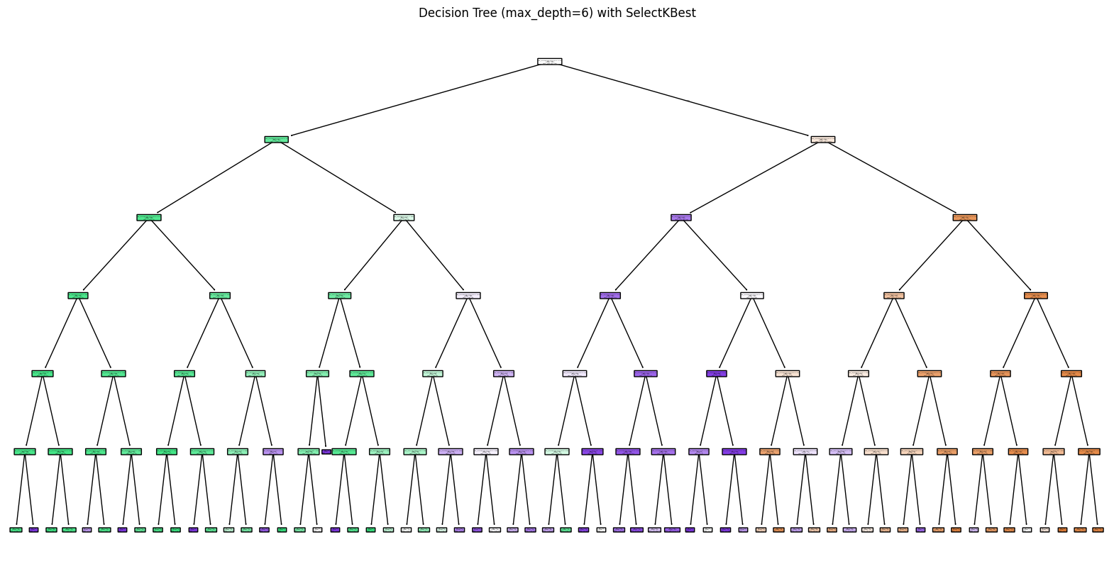

Slide 41
Gini vs Entropy
# Fonction Gini impurity
def gini_impurity(labels):
total = len(labels)
if total == 0:
return 0
counts = Counter(labels)
impurity = 1.0
for count in counts.values():
prob = count / total
impurity -= prob ** 2
return impurity
gini_train = gini_impurity(y_train)
print(f"Gini impurity for root node (y_train):{gini_train:.4f}")
#calcul de l'entropy
import math
def entropy(labels):
total = len(labels)
if total == 0:
return 0
counts = Counter(labels)
ent = 0.0
for count in counts.values():
prob = count / total
ent -= prob * math.log2(prob)
return ent
ent_train = entropy(y_train)
print(f"Entropy for root node (y_train): {ent_train:.4f}")
Entropy for root node(y_train):1.5850
Gini impurity for root node(y_train):0.6667
Gini est plus rapide à calculer.
Entropy est plus théoriquement fondée (information gain).

Slide 42
📊 Analyse
✔️ Entropy = 1.5850
Ce résultat est quasiment égal à log₂(3) ≈ 1.58496.
Cela signifie que tes classes (Low, Medium, High) sont presque également réparties dans y_train.
En effet, l’entropie est maximale quand les classes sont également probables (ex : 33%, 33%, 33%).
✔️ Gini = 0.6667
Le Gini maximum pour 3 classes équilibrées est :
1−(1/3+1/3+1/3)=1−3*1/9=1−1/3=0.6667
Donc le résultat montre aussi une distribution équilibrée des classes.

Slide 43
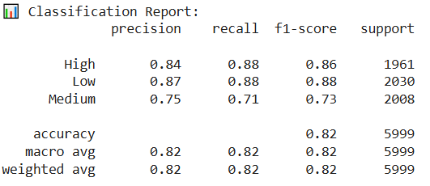
Confusion Matrix
#Rapport de classification et matrice de confusion
print("\n📊 Classification Report:")
print(classification_report(y_test, y_test_pred))
cm = confusion_matrix(y_test, y_test_pred, labels=pipeline.named_steps['classifier'].classes_)
disp = ConfusionMatrixDisplay(confusion_matrix=cm, display_labels=pipeline.named_steps['classifier'].classes_)
plt.figure(figsize=(6, 6))
disp.plot(cmap='Blues', values_format='d')
plt.title("Confusion Matrix")
plt.grid(False)
plt.show()
Macro average treats all classes equally → shows balanced class performance.
Weighted average considers class imbalance (slightly favoring more frequent classes).

Slide 44
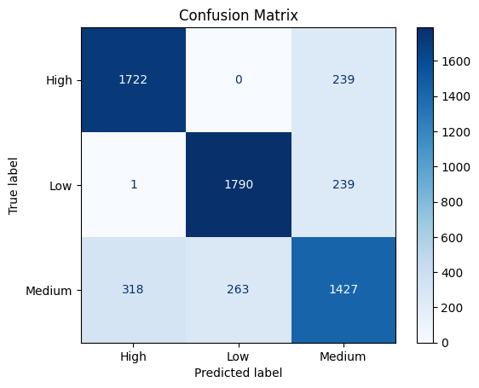
Model performs well on “High” and “Low” categories.
🟦 High Class
True Positives: 1722 correctly classified as High.
Most errors: 239 misclassified as Medium.
No Highs misclassified as Low, which is good.
✅ Strong performance on this class.
🟨 Low Class
True Positives: 1790 correctly classified.
239 misclassified as Medium (common confusion).
Only 1 instance misclassified as High.
✅ Very accurate prediction for Low.
🟧 Medium Class
True Positives: 1427 (lower than others).
318 Mediums wrongly predicted as High.
263 misclassified as Low.
🔻 Weakest performance is on this class.

Slide 45
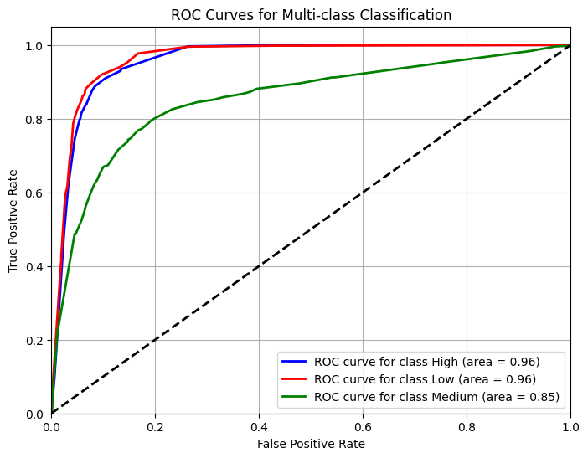
ROC and AUC
# Classes dans le bon ordre
classes = pipeline.named_steps['classifier'].classes_ # Binariser les labels true (test)
y_test_bin = label_binarize(y_test, classes=classes) # Probabilités prédites par le modèle (sur test)
y_score = pipeline.predict_proba(X_test) # Calcul des courbes ROC et AUC pour chaque classe
fpr = dict()
tpr = dict()
roc_auc = dict() for i, cls in enumerate(classes):
fpr[i], tpr[i], _ = roc_curve(y_test_bin[:, i], y_score[:, i])
roc_auc[i] = auc(fpr[i], tpr[i])
# Plot
plt.figure(figsize=(8, 6))
colors = ['blue', 'red', 'green']
for i, color in enumerate(colors):
plt.plot(fpr[i], tpr[i], color=color, lw=2,
label=f'ROC curve for class {classes[i]} (area = {roc_auc[i]:.2f})')
plt.plot([0, 1], [0, 1], 'k--', lw=2) # ligne diagonale
plt.xlim([0.0, 1.0])
plt.ylim([0.0, 1.05])
plt.xlabel('False Positive Rate')
plt.ylabel('True Positive Rate')
plt.title('ROC Curves for Multi-class Classification')
plt.legend(loc="lower right")
plt.grid(True)
plt.show()

Slide 46
SVM
1-Accuracy
2-Confusion Matrix
2-ROC and AUC

Slide 47
Accuracy
from sklearn.svm import SVC
from sklearn.metrics import accuracy_score, classification_report, confusion_matrix, ConfusionMatrixDisplay
# --- Pipeline SVM ---
svm_pipeline = Pipeline([
('preprocessor', preprocessor),
('feature_selection', SelectKBest(score_func=f_classif, k=5)),#k à adapter si besoin
('classifier', SVC(kernel='rbf', probability=True, random_state=42))#'rbf' par défaut,avec proba pour ROC
])
# --- Entraînement ---
svm_pipeline.fit(X_train, y_train)
# --- Prédictions ---
y_train_pred_svm = svm_pipeline.predict(X_train)
y_test_pred_svm = svm_pipeline.predict(X_test)
# --- Accuracies ---
train_acc_svm = accuracy_score(y_train, y_train_pred_svm)
test_acc_svm = accuracy_score(y_test, y_test_pred_svm)
print(f"✅ [SVM] Training Accuracy: {train_acc_svm:.4f}")
print(f"✅ [SVM] Testing Accuracy: {test_acc_svm:.4f}")
✅ [SVM] Training Accuracy: 0.8173
✅ [SVM] Testing Accuracy: 0.8178

Slide 48
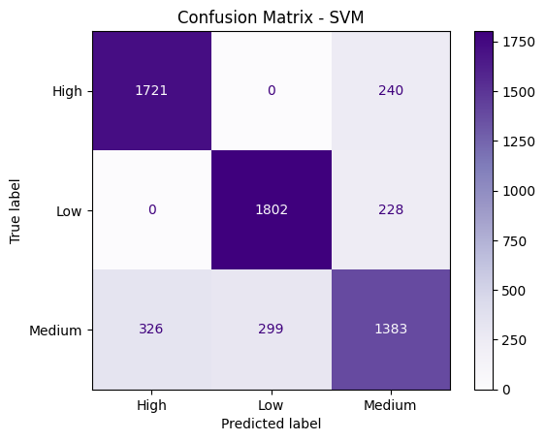
Confusion Matrix
print("\n📊 [SVM] Classification Report:")
print(classification_report(y_test, y_test_pred_svm))
cm_svm = confusion_matrix(y_test, y_test_pred_svm, labels=svm_pipeline.named_steps['classifier'].classes_)
disp_svm = ConfusionMatrixDisplay(confusion_matrix=cm_svm, display_labels=svm_pipeline.named_steps['classifier'].classes_)
plt.figure(figsize=(6, 6))
disp_svm.plot(cmap='Purples', values_format='d')
plt.title("Confusion Matrix - SVM")
plt.grid(False)
plt.show()

Slide 49
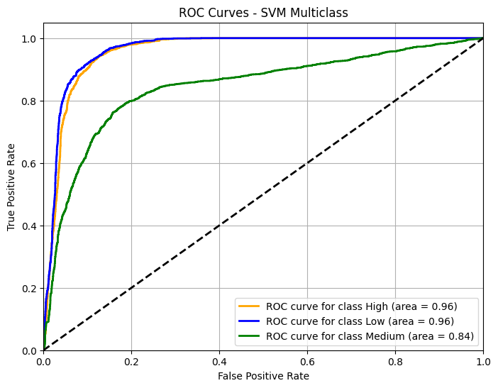
ROC and AUC
# Binariser les classes
y_test_bin_svm = label_binarize(y_test, classes=svm_pipeline.named_steps['classifier'].classes_) # Probabilités
y_score_svm = svm_pipeline.predict_proba(X_test) # ROC et AUC
fpr_svm = dict()
tpr_svm = dict()
roc_auc_svm = dict() for i, cls in enumerate(svm_pipeline.named_steps['classifier'].classes_):
fpr_svm[i], tpr_svm[i], _ = roc_curve(y_test_bin_svm[:, i], y_score_svm[:, i])
roc_auc_svm[i] = auc(fpr_svm[i], tpr_svm[i])
# Plot
plt.figure(figsize=(8, 6))
colors = ['orange', 'blue', 'green']
for i, color in enumerate(colors):
plt.plot(fpr_svm[i], tpr_svm[i], color=color, lw=2,
label=f'ROC curve for class {svm_pipeline.named_steps["classifier"].classes_[i]} (area = {roc_auc_svm[i]:.2f})') plt.plot([0, 1], [0, 1], 'k--', lw=2)
plt.xlim([0.0, 1.0])
plt.ylim([0.0, 1.05])
plt.xlabel('False Positive Rate')
plt.ylabel('True Positive Rate')
plt.title('ROC Curves - SVM Multiclass')
plt.legend(loc="lower right")
plt.grid(True)
plt.show()

Slide 50
Conclusion
NN:
✅ Training Accuracy: 0.8281
✅ Testing Accuracy: 0.8236
✅ [SVM] Training Accuracy: 0.8173
✅ [SVM] Testing Accuracy: 0.8178
DT: ✅ Training Accuracy: 0.8322
✅ Testing Accuracy: 0.8233
Neural Network and Decision Tree models both achieved
around 82% accuracy, while SVM performed slightly lower
at 81%, showing comparable but slightly weaker performance.

Slide 51
Conclusion
NN:
AUC=0.97 (1)
AUC=0.97 (2)
AUC=0.87 (3)
DT:
AUC=0.96 (1)
AUC=0.96 (2)
AUC=0.85 (3)
SVM:
AUC=0.96 (1)
AUC=0.96 (2)
AUC=0.84 (3)

